Slide 1
Natural Language processing
UNIT 5

Slide 2
Natural Language Processing (NLP)
Natural Language Processing (NLP) refers to AI method of communicating with an intelligent systems using a natural language such as English.
Processing of Natural Language is required when you want an intelligent system like robot to perform as per your instructions, when you want to hear decision from a dialogue based clinical expert system, etc.
The field of NLP involves making computers to perform useful tasks with the natural languages humans use.

Slide 3
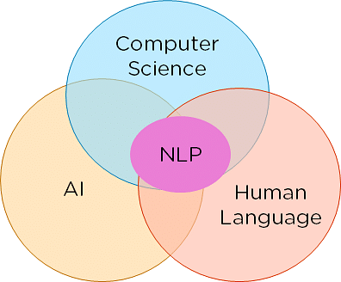
Natural Language Processing
Natural Language Processing or NLP refers to the branch of Artificial Intelligence that gives the machines the ability to read, understand and derive meaning from human languages.
NLP combines the field of linguistics and computer science to decipher language structure and guidelines and to make models which can comprehend, break down and separate significant details from text and speech.

Slide 4
Components of NLP
There are two components of NLP as given −
Natural Language Understanding (NLU)
Understanding involves the following tasks −
Mapping the given input in natural language into useful representations.
Analyzing different aspects of the language.

Slide 5
Natural Language Generation (NLG)
It is the process of producing meaningful phrases and sentences in the form of natural language from some internal representation.
It involves −
Text planning − It includes retrieving the relevant content from knowledge base.
Sentence planning − It includes choosing required words, forming meaningful phrases, setting tone of the sentence.
Text Realization − It is mapping sentence plan into sentence structure.

Slide 6
Difficulties in NLU
NL has an extremely rich form and structure.
It is very ambiguous. There can be different levels of ambiguity
Lexical ambiguity − It is at very primitive level such as word-level.
For example, treating the word “board” as noun or verb?

Slide 7
Difficulties in NLU
Syntax Level ambiguity − A sentence can be parsed in different ways.
For example, “He lifted the beetle with red cap.” − Did he use cap to lift the beetle or he lifted a beetle that had red cap?

Slide 8
Difficulties in NLU
Referential ambiguity −
Referring to something using pronouns.
For example, Rima went to Gauri. She said, “I am tired.” − Exactly who is tired?
One input can mean different meanings.
Many inputs can mean the same thing.

Slide 9
NLP Terminology
Phonology − It is study of organizing sound systematically.
Morphology − It is a study of construction of words from primitive meaningful units.
Morpheme − It is primitive unit of meaning in a language.
Syntax − It refers to arranging words to make a sentence. It also involves determining the structural role of words in the sentence and in phrases.
Semantics − It is concerned with the meaning of words and how to combine words into meaningful phrases and sentences.

Slide 10
NLP Terminology
Pragmatics − It deals with using and understanding sentences in different situations and how the interpretation of the sentence is affected.
Discourse − It deals with how the immediately preceding sentence can affect the interpretation of the next sentence.
World Knowledge − It includes the general knowledge about the world.

Slide 11
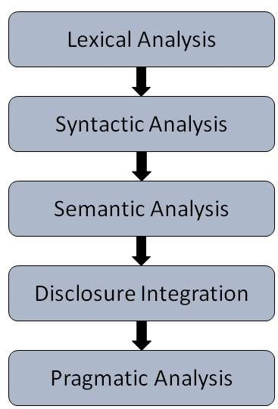
Steps in NLP

Slide 12
Lexical Analysis
It involves identifying and analyzing the structure of words.
Lexicon of a language means the collection of words and phrases in a language.
Lexical analysis is dividing the whole chunk of text into paragraphs, sentences, and words.

Slide 13
Syntactic Analysis (Parsing)
It involves analysis of words in the sentence for grammar and arranging words in a manner that shows the relationship among the words.
The sentence such as “The school goes to boy” is rejected by English syntactic analyzer.

Slide 14
Semantic Analysis
It draws the exact meaning or the dictionary meaning from the text.
The text is checked for meaningfulness. It is done by mapping syntactic structures and objects in the task domain.
The semantic analyzer disregards sentence such as “hot ice-cream”.

Slide 15
Discourse Integration
The meaning of any sentence depends upon the meaning of the sentence just before it.
In addition, it also brings about the meaning of immediately succeeding sentence.

Slide 16
Pragmatic Analysis
During this, what was said is re-interpreted on what it actually meant.
It involves deriving those aspects of language which require real world knowledge.

Slide 17
What is Syntactic Processing?
Syntactic processing is the process of analyzing the grammatical structure of a sentence to understand its meaning.
This involves identifying the different parts of speech in a sentence, such as nouns, verbs, adjectives, and adverbs,
and how they relate to each other in order to give proper meaning to the sentence.

Slide 18
Let’s start with an example to understand Syntactic Processing:
New York is the capital of the United States of America.
Is the United States of America the of New York capital.
If we observe closely, both sentences have the same set of words, but only the first one is grammatically correct and which have proper meaning.
If we approach both sentences with lexical processing techniques, we can’t tell the difference between the two sentences.

Slide 19
In syntactic processing, our aim is to understand the roles played by each of the words in the sentence, and the relationship among words and to parse the grammatical structure of sentences to understand the proper meaning of the sentence.

Slide 20
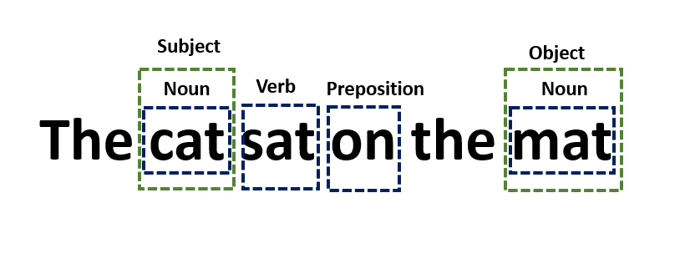
How Does Syntactic Processing Work?
For example, consider the sentence “The cat sat on the mat.” Syntactic processing would involve identifying important components in the sentence such as “cat” as a noun, “sat” as a verb, “on” as a preposition, and “mat” as a noun. It would also involve understanding that “cat” is the subject of the sentence and “mat” is the object.

Slide 21
Syntactic processing involves a series of steps, including tokenization, part-of-speech tagging, parsing, and semantic analysis.
Tokenization is the process of breaking up a sentence into individual words or tokens.
Part-of-speech (PoS) tagging involves identifying the part of speech of each token.
Parsing is the process of analyzing the grammatical structure of a sentence, including identifying the subject, verb, and object.
The semantic analysis involves understanding the meaning of the sentence in context.

Slide 22
Why Is Syntactic Processing Important in NLP?
Syntactic processing is a crucial component of many NLP tasks, including machine translation, sentiment analysis, and question-answering.
Without accurate syntactic processing, it is difficult for computers to understand the underlying meaning of human language.
Syntactic processing also plays an important role in text generation, such as in chatbots or automated content creation.
By understanding the grammatical structure of a sentence, computers can generate more natural and fluent textual content.

Slide 23
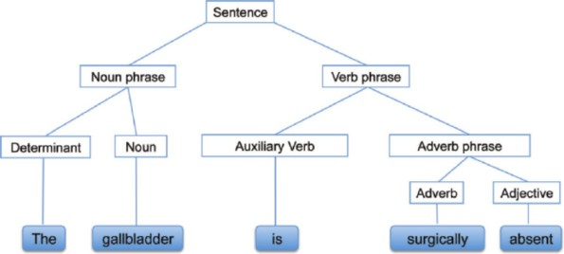

Slide 24
What Is Semantic Analysis?
semantic analysis is the process of drawing meaning from text.
It allows computers to understand and interpret sentences, paragraphs, or whole documents, by analyzing their grammatical structure, and identifying relationships between individual words in a particular context.
It’s an essential sub-task of Natural Language Processing (NLP) and the driving force behind machine learning tools like chatbots, search engines, and text analysis.
Semantic analysis-driven tools can help companies automatically extract meaningful information from unstructured data, such as emails, support tickets, and customer feedback

Slide 25
Critical elements of semantic analysis
Hyponyms: This refers to a specific lexical entity having a relationship with a more generic verbal entity called hypernym. For example, red, blue, and green are all hyponyms of color, their hypernym.
Meronomy: Refers to the arrangement of words and text that denote a minor component of something. For example, mango is a meronomy of a mango tree.
Polysemy: It refers to a word having more than one meaning. However, it is represented under one entry. For example, the term ‘dish’ is a noun. In the sentence, ‘arrange the dishes on the shelf,’ the word dishes refers to a kind of plate.

Slide 26
Critical elements of semantic analysis
Synonyms: This refers to similar-meaning words. For example, abstract (noun) has a synonyms summary–synopsis.
Antonyms: This refers to words with opposite meanings. For example, cold has the antonyms warm and hot.
Homonyms: This refers to words with the same spelling and pronunciation, but reveal a different meaning altogether. For example, bark (tree) and bark (dog).

Slide 27
Semantic Analysis Techniques
Semantic Classification Models
Topic classification: sorting text into predefined categories based on its content. Customer service teams may want to classify support tickets as they drop into their help desk. Through semantic analysis, machine learning tools can recognize if a ticket should be classified as a “Payment issue” or a “Shipping problem.”

Slide 28
Semantic Analysis Techniques
Semantic Classification Models
Sentiment analysis: detecting positive, negative, or neutral emotions in a text to denote urgency. For example, tagging Twitter mentions by sentiment to get a sense of how customers feel about your brand, and being able to identify disgruntled customers in real time.
Intent classification: classifying text based on what customers want to do next. You can use this to tag sales emails as “Interested” and “Not Interested” to proactively reach out to those who may want to try your product.

Slide 29
Semantic Extraction Models
Keyword extraction: finding relevant words and expressions in a text. This technique is used alone or alongside one of the above methods to gain more granular insights. For instance, you could analyze the keywords in a bunch of tweets that have been categorized as “negative” and detect which words or topics are mentioned most often.

Slide 30
Semantic Extraction Models
Entity extraction: identifying named entities in text, like names of people, companies, places, etc. A customer service team might find this useful to automatically extract names of products, shipping numbers, emails, and any other relevant data from customer support tickets

Slide 31
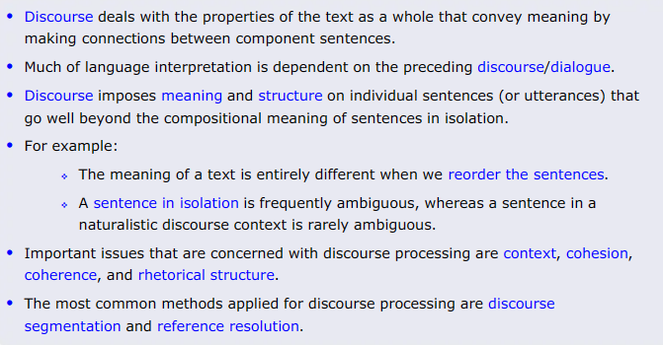
Discourse & pragmatic processing.

Slide 32
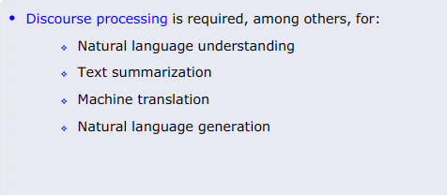

Slide 33
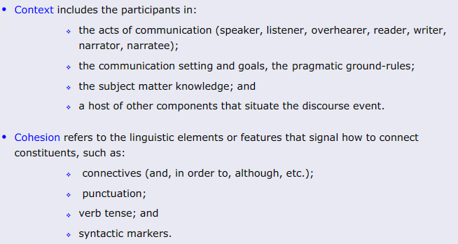

Slide 34
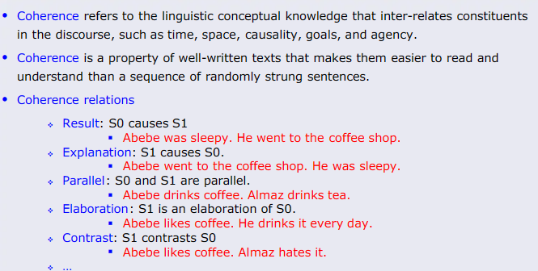

Slide 35
Importance of Pragmatics in NLP
The concept of pragmatics holds excellent importance for Natural Language Processing(NLP). It makes machines understand spoken and written language better. Pragmatics in NLP analyses the context and helps machines understand how it changes the meaning of utterances. NLP systems have been facing problems in their regard for a long time.
Through a few examples, let’s try to understand what would happen if pragmatics didn’t exist.
Example 1
‘Can you pull the car over?’
Actual Meaning: Are you capable of pulling(literally pulling) the car? Pragmatic Meaning: This means ‘Can you stop the car’ .

Slide 36
Example 2
“Wow, that’s just what I needed.”
Actual Meaning: This may mean that someone was looking for something, and they found it. The sentence gives a positive sentiment here.
Pragmatic Meaning: This could express sarcasm and negative sentiment in a specific situation.

Slide 37
Aspects Of Pragmatics
Deixis
Deixis refers to words and phrases that show time, place, or situation when someone is talking. It refers to words or phrases such as “me,” “here,” etc., which are difficult to understand without additional information.
Example:
1) Meet me here.
2) I wish you’d been here yesterday.

Slide 38
Aspects Of Pragmatics
Implicature
Implicature means that more information is communicated than being said.
There are two types, namely,
Conversational Implicature
Conversational implicature is also known as Implication. It happens when the speaker says something that requires interpretation. It is an indirect way of saying something. It relies upon the cooperative principle.

Slide 39
Aspects Of Pragmatics
Example:
Person A: I am out of gas.
Person B: The gas station is around the corner.
Here it is implied that the gas station is near and open so that person A can go and fill in the gas.
Conventional implicature
Conventional implicature is directly attached to the literal meaning of the words. It does not rely on the cooperative principle.
Example: Abhishek is rich but sad.

Slide 40
Presupposition
A presupposition is when the speaker assumes something as a case before making an utterance.
Example: Jane no longer writes fiction.
Here it is assumed that Jane once wrote fiction.

Slide 41
Speech Act
A Speech Act is when the sentence conveys an action rather than saying something.
Example: I smashed a potato.
Here the action of smashing a potato is depicted.

